Slide 1
House of Mystery
PHP Hidden Item Game
By: Jiawen Li, Isaiah Smith, Tin Huynh, Hyunki Lee
Team 8: Mysterious Team

Slide 2
Assigned Tasks
Designer/Developer: Isaiah Smith. Designed and developed login, signup, login function, and signup function.
Leader/Designer/Developer: Tin Huynh. Designed and developed game mechanism, scoring system, and leader’s board.
Developer/QA: Hyunki Lee. Designed class diagrams, testing and debugging for errors.
Developer/QA: Jiawen Li. Designed styling for the games, testing and debugging for errors.
In this project, we created, designed, and developed the hidden item game.
https://github.com/thuyn789/hidden-item-php-game

Slide 3
What is the Hidden object game
Find the items from a list that are hidden within a picture
Test your ability to find items within a setting in order to progress the storyline

Slide 4
Tip for hidden games
#1 search by the item color
#2 search by shape
#3 check inconspicuous areas
#4 relaxation and confidence
# 5 take a break and research again

Slide 5
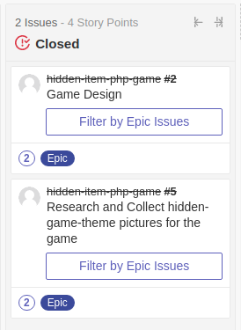
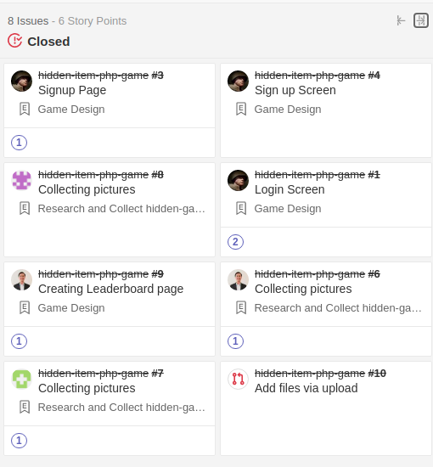
Discord and Zenhub
Most communication happened in Discord.
We used Zenhub to organize and plan the coding in a very effective way.
Since this is a small-scale project, we created two epics and eight issues.

Slide 6
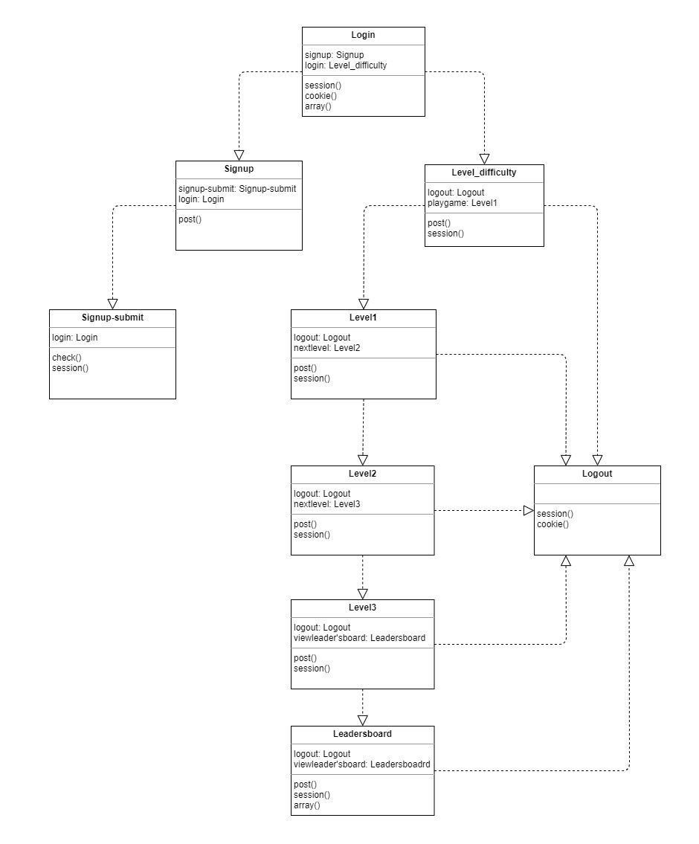
UML-Diagram
Relationship between each class
Main functions are represented in each class

Slide 7
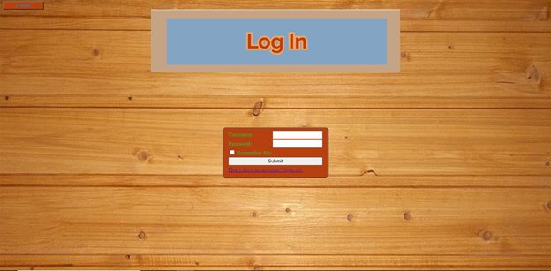
Login Page
Simple Login Form
Prompts User for
Username
Password
“Remember Me” saves username as cookie
Link to Sign up Page.
Logout Button.

Slide 8
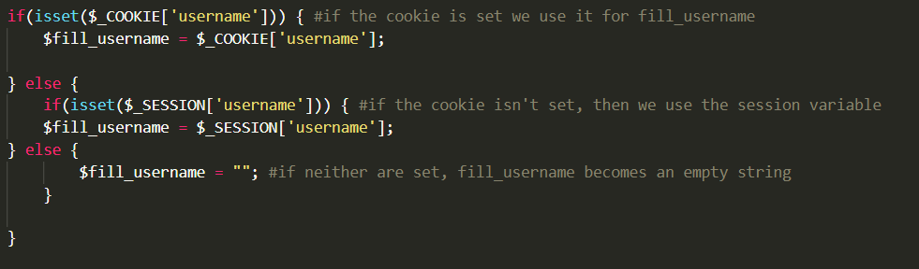
Login Page PHP Code
If the username cookie is set, used to set ‘fill_username’ value for the username textfield
If the cookie isn’t set, the session variable is used to fill_username’
If neither are set, the variable is left empty.

Slide 9
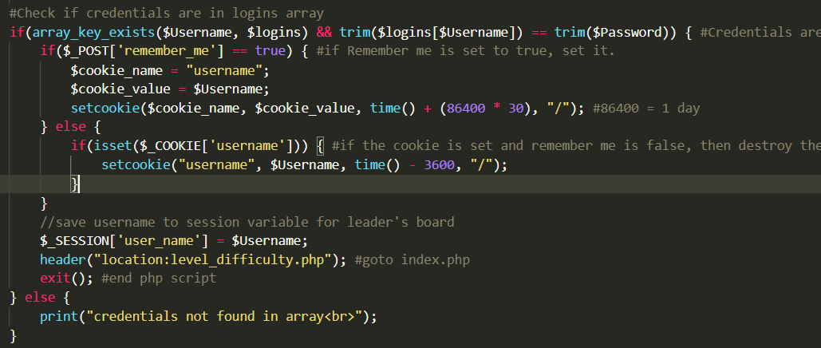
Login Page PHP Code
If ‘Remember Me’ is set, the username cookie is set.
Otherwise, the username cookie is destroyed.
Regardless, the username session variable is set and user is sent off the page.

Slide 10
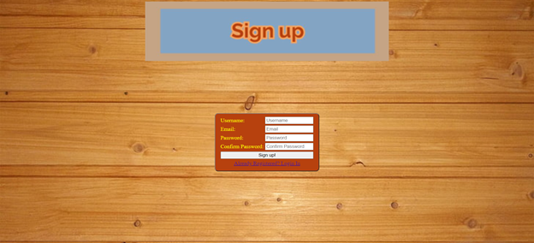
Sign up Page
Simple Form
Records
Username
Email
Password
Pressing Signup sends user to signup-submit page.
If password and confirm password don’t match, submit page tells user to try again.

Slide 11
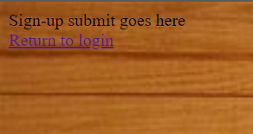
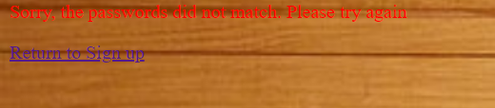
Signup-Submit Page
If the passwords match, prompts user to return to login page.
If the passwords don’t match, prompts user to return to sign up page.

Slide 12
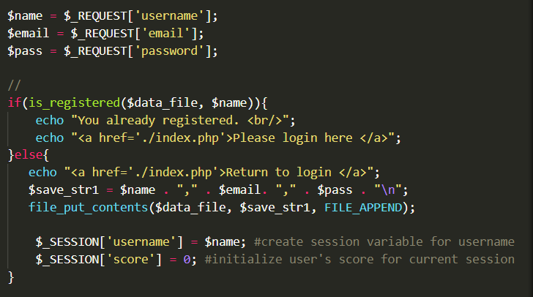
Signup-Submit PHP Code
When the username’s match, string with the username, password, and email are saved and written to the user_account.txt file.
The session variables ‘username’ and ‘score’ are created.

Slide 13
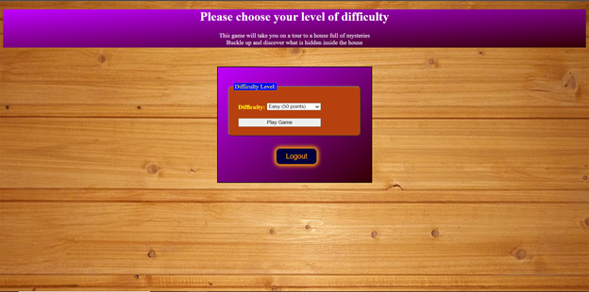
Difficulty Level

Slide 14
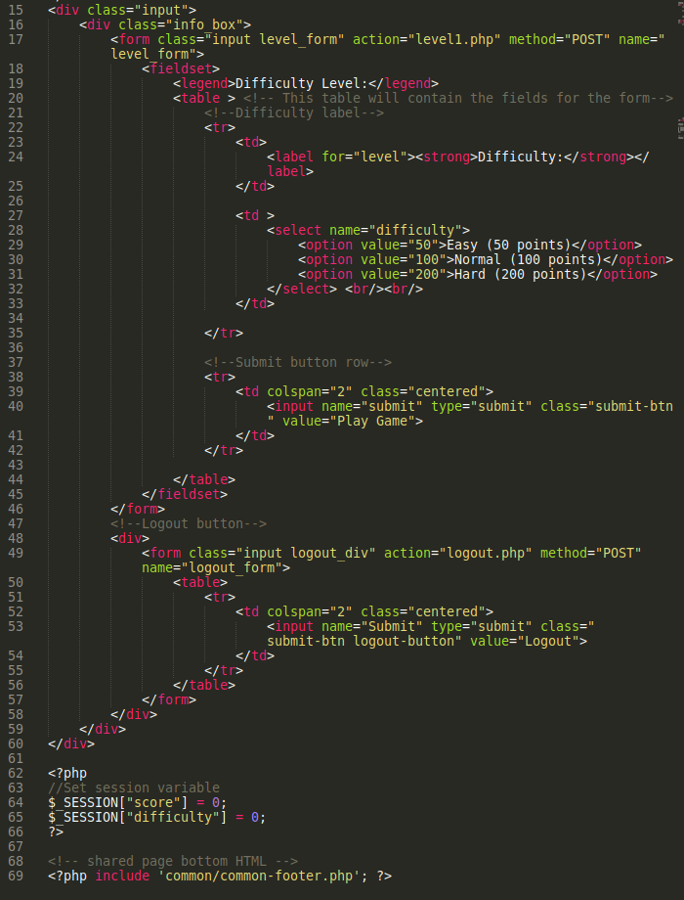
Level Difficulty Code
There are three level of difficulties: easy, normal and hard.
When you select one of the options, the game will bring you to different mode.

Slide 15
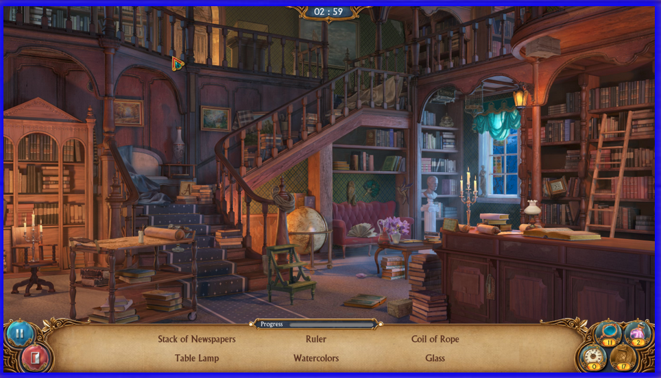
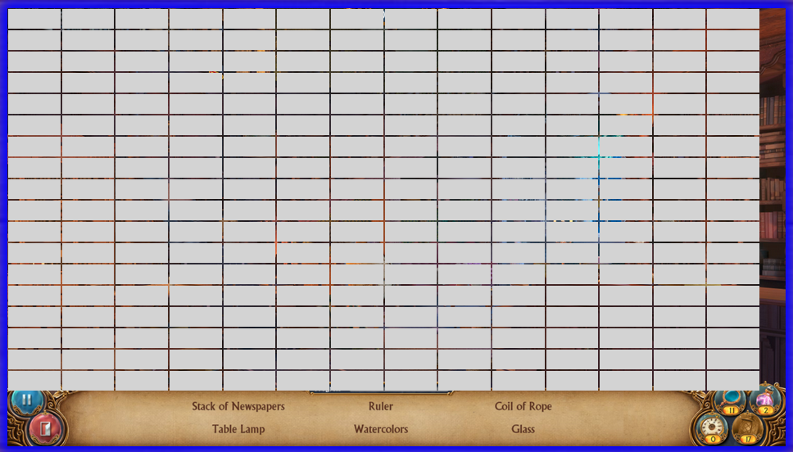
Game Engine - Table Mapping Method

Slide 16
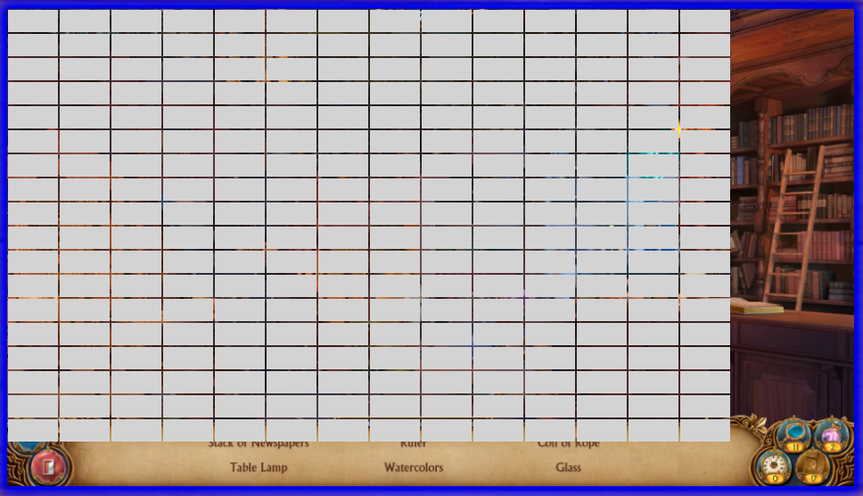
Game Engine - Table Mapping (cont.)
Google Chrome
Firefox

Slide 17
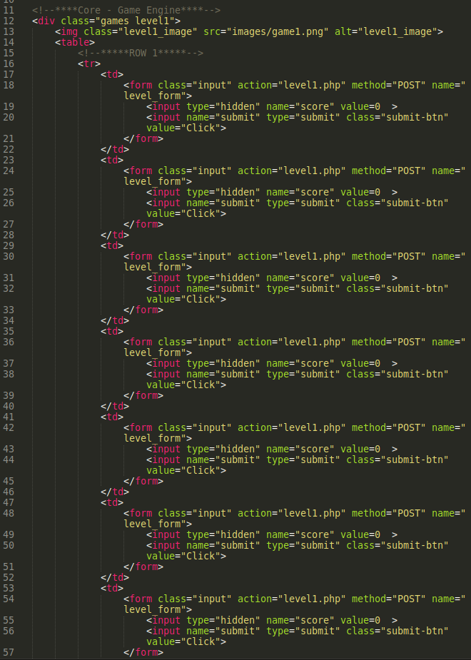
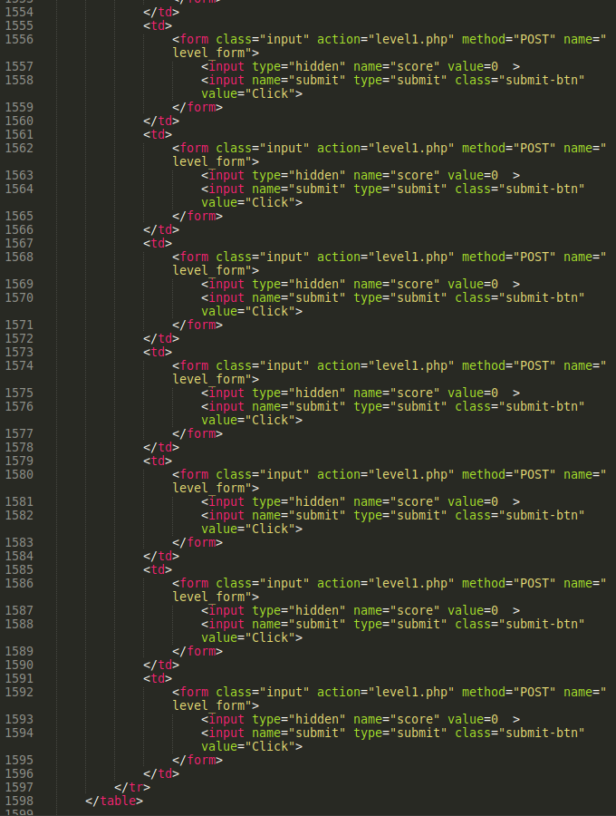
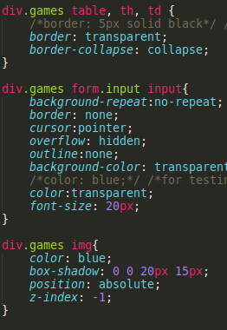
Game Engine - Sample Code

Slide 18
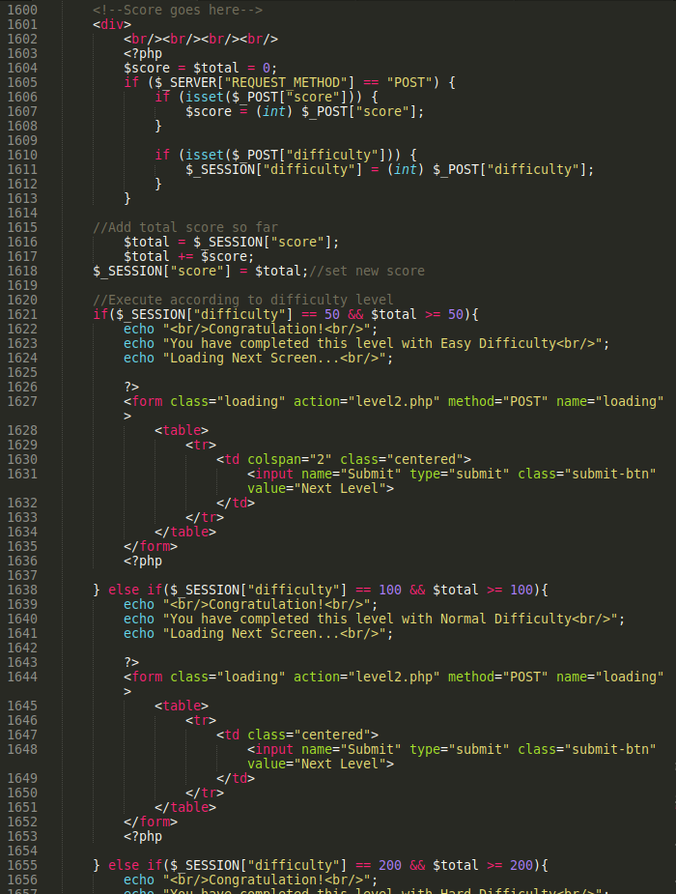
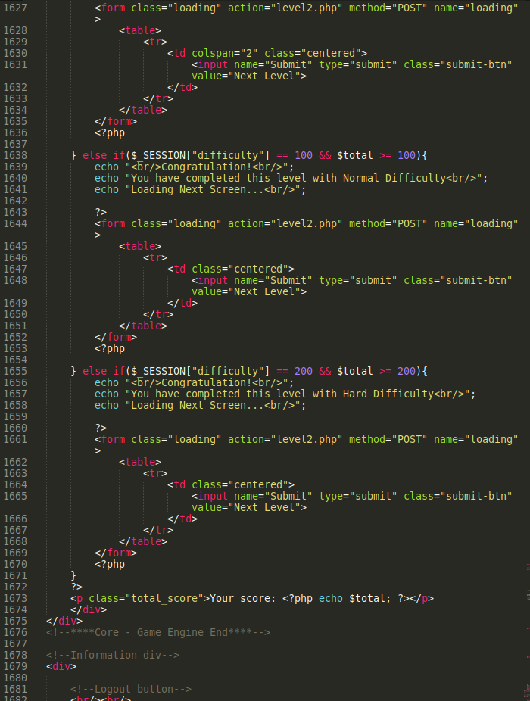
Score System

Slide 19
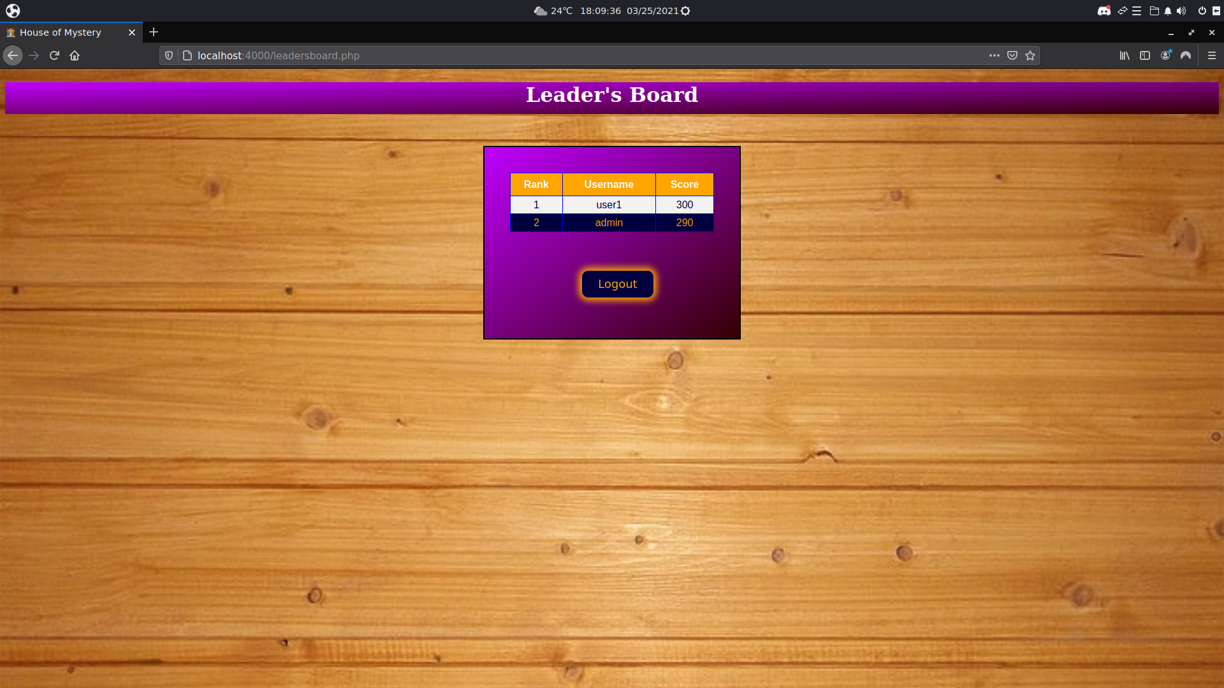
Leader’s Board

Slide 20
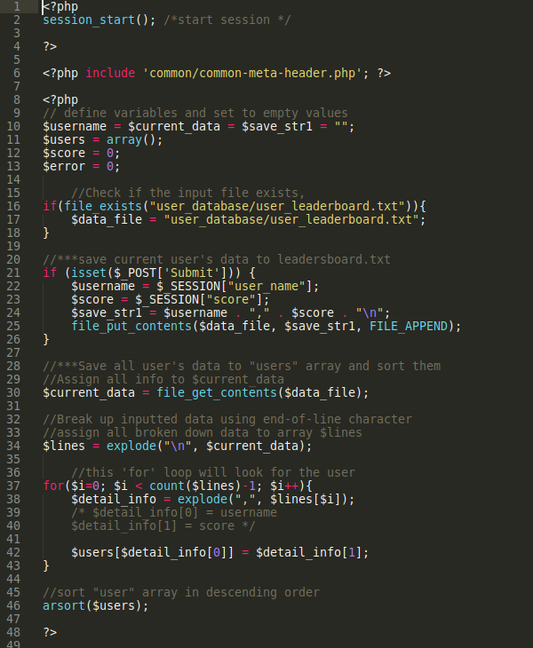
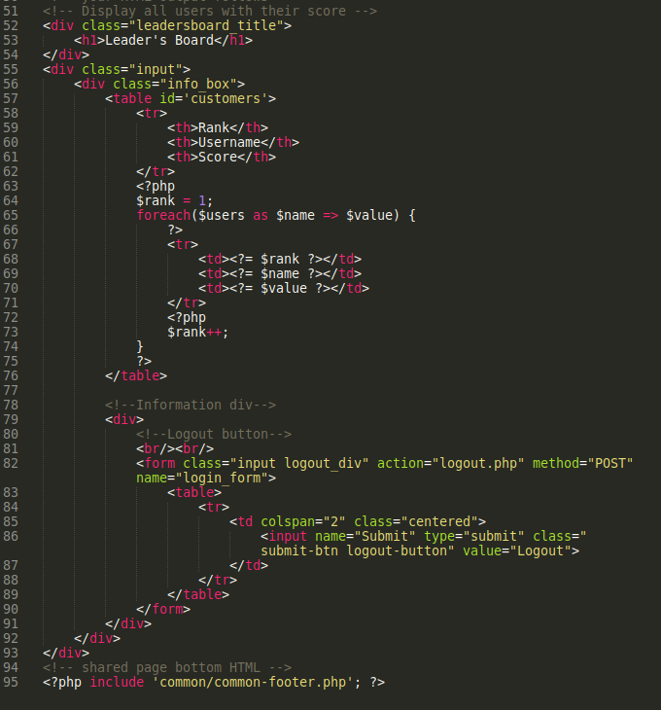
Leader’s Board Code

Slide 21
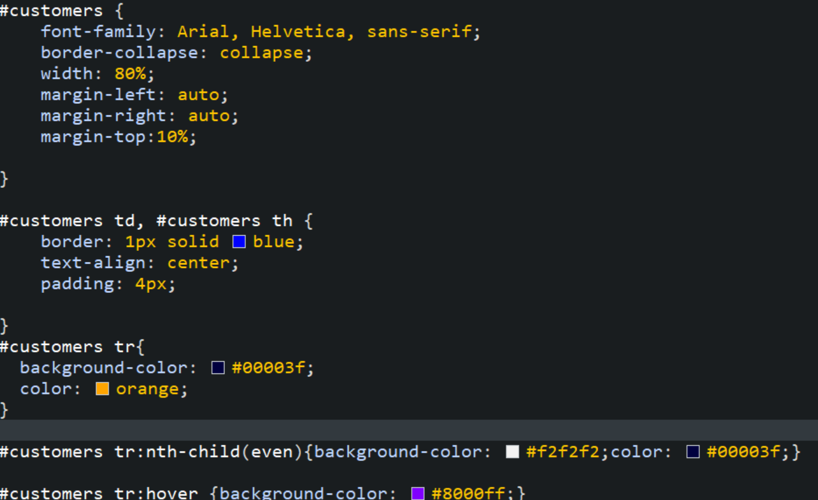

Slide 22
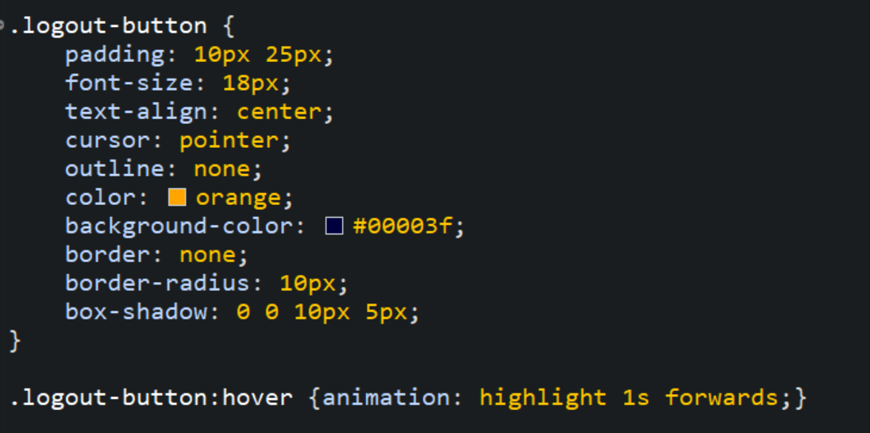

Slide 23
Game Demo

